Slide 1

Vfriends: Connecting Students & Problem Solvers to Excel Together
Vfriends is dedicated to fostering a collaborative environment where every student at VIT can thrive, both academically and personally.

Slide 2
The Challenge Students Face at VIT
Unresolved Doubts
Lack of Community
Finding Mentors
Academic and non-academic questions frequently go unanswered due to time constraints, hindering progress.
A centralized, supportive platform for quick, reliable help is often missing.
Students struggle to identify motivated and reliable peer problem solvers.

Slide 3
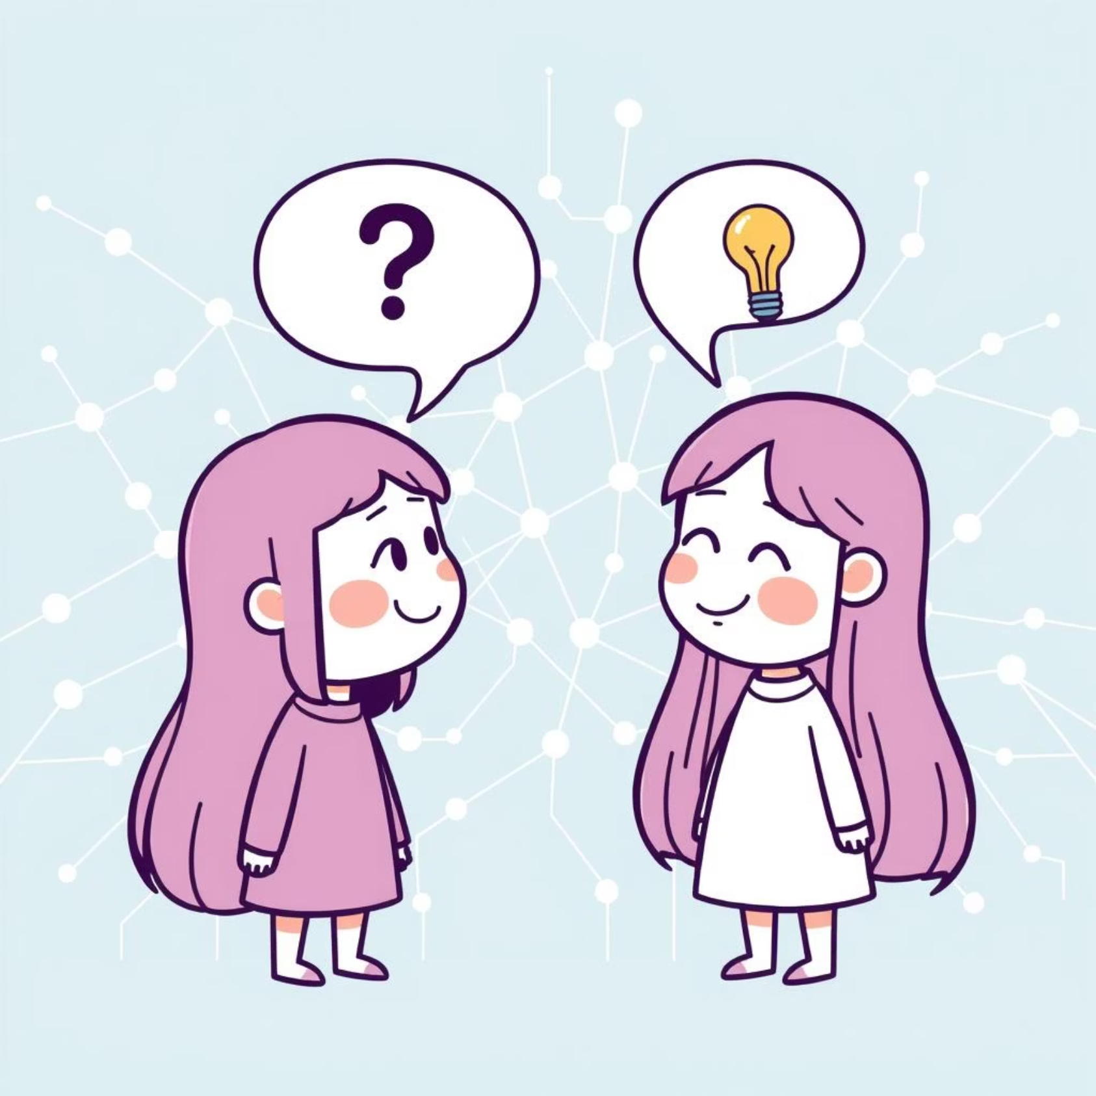
Introducing Vfriends: Your Academic & Social Hub
Vfriends is an intuitive platform designed to help VIT students overcome their challenges by connecting them with a supportive community. It's a place where learning and collaboration flourish.
Connect to solve academic and personal doubts.
Engage as a Student seeking help or a Problem Solver offering it.
Build a vibrant community focused on mutual growth.

Slide 4


Dual Roles Explained: Student & Problem Solver
The Student
The Problem Solver
Posts academic queries, project roadblocks, or non-academic questions anytime, ensuring timely assistance.
Provides clear, quality answers and guidance, fostering a culture of peer-to-peer learning and mentorship.

Slide 5
Gamification: Points, Ratings & Daily Streaks
1
2
3
Earn Points
Dynamic Ratings
Daily Streaks
Problem Solvers gain points for every successfully resolved doubt, recognizing their effort.
Ratings update in real-time based on the quality and volume of help provided.
Maintain a daily streak to motivate consistent participation and enhance engagement.

Slide 6

Why Gamification Matters
Fosters healthy competition and peer recognition among problem solvers.
Encourages sustained involvement and deeper mastery of various subjects.
Helps students quickly identify the most effective and reliable problem solvers.

Slide 7



How Vfriends Benefits Students
Faster Resolution
Diverse Perspectives
Reduced Stress
Quick doubt resolution directly translates to improved academic performance and timely project completion.
Access a wide range of problem-solving approaches, broadening understanding and critical thinking skills.
Gain confidence and alleviate academic stress through consistent, reliable support from peers.

Slide 8
Building a Supportive Social Network
Beyond academics, Vfriends is a platform for building genuine connections, sharing experiences, and nurturing friendships within the VIT community.
Encourages collaboration and empathy among students.
Provides a safe space for both academic and personal discussions.
Fosters a strong sense of community spirit and belonging.

Slide 9
Vision: Empowering VIT Students to Excel Together
Create Lifelong Connections
Bridge Academic Gaps
Build a thriving student ecosystem that extends beyond graduation.
Foster Mutual Help
Leverage technology to provide accessible, immediate academic assistance.
Cultivate a campus culture of collaborative learning and continuous support.

Slide 10


Join Vfriends Today: Solve, Socialize, Succeed
Become an integral part of our growing community.
100%
Earn
Grow
Inclusion
Reputation
Together
Everyone belongs, whether you're seeking help or offering expertise.
Gain points, build your profile, and maintain your problem-solving streak.
Achieve academic excellence and effortless social connection through collaboration.

